Slide 1
Mean Force Integration
Free energy surfaces from independent
biased MD simulations
Antoniu Bjola
Matteo Salvalaglio
University College London

Slide 2

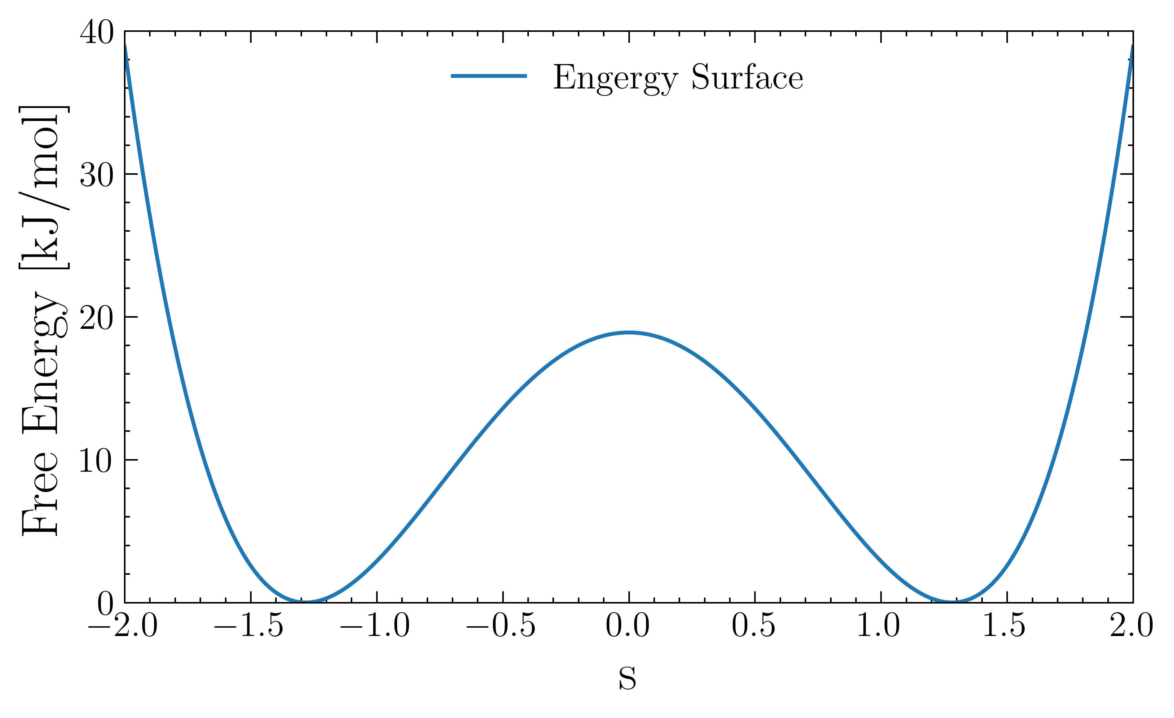
Enhanced Sampling - Methods

Slide 3
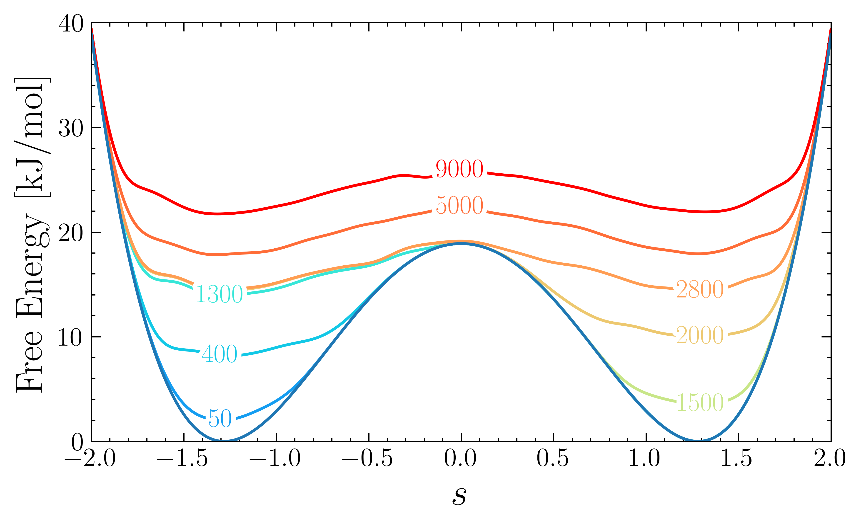
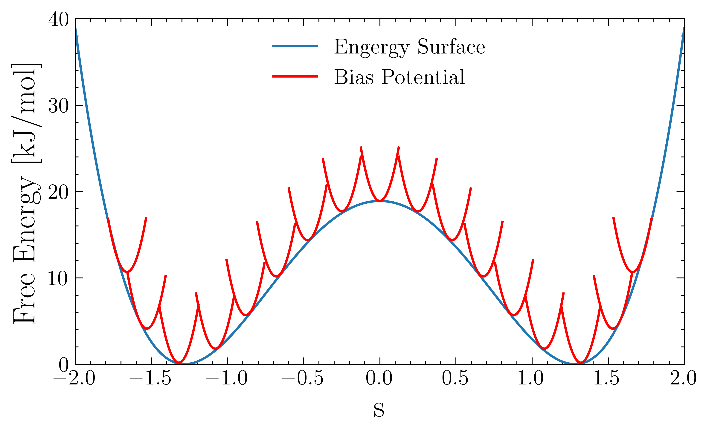
Enhanced Sampling - Methods
Metadynamics
Umbrella sampling
Autonomous exploration
Restricted parallelization
Can’t combine independent simulations
Independent simulations
Controlled sampling
Requires knowledge of CV space
[1] Laio A.; Parrinello M. “Escaping free-energy minima”. Proc. Natl. Acad. Sci. 2002
[2] Barducci A.; Bussi G.; Parrinello M. “Well-tempered metadynamics” Phys. Rev. Lett. 2008
[3] Torrie G.; Valleau J. “Nonphysical sampling distributions in Monte Carlo free-energy estimation: Umbrella sampling”. J. Comput. Phys. 1977

Slide 4
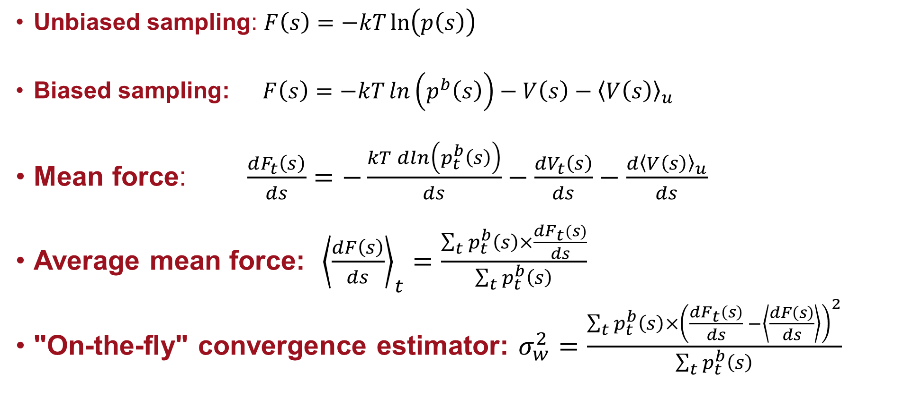
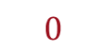
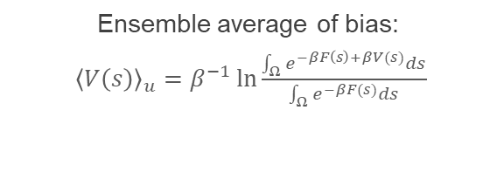
Mean Force Integration
Ensemble average of bias:
${\left\langle V\left(s\right)\right\rangle }_{u}=β^{−1}\ln{\frac{\int_{Ω}{e^{−βF\left(s\right)+βV(s)}ds}}{\int_{Ω}{e^{−βF(s)}ds}}}$
Unbiased sampling: $F\left(s\right)=−kT\ln\left(p\left(s\right)\right)$
Biased sampling: $F\left(s\right)=−kT\ln\left(p^{b}\left(s\right)\right)−V\left(s\right)−{\left\langle V\left(s\right)\right\rangle }_{u}$
Mean force: $\frac{dF_{t}\left(s\right)}{ds}=−\frac{kT\operatorname{dln}\left(p_{t}^{b}\left(s\right)\right)}{ds}−\frac{{dV}_{t}\left(s\right)}{ds}−\frac{{d\left\langle V\left(s\right)\right\rangle }_{u}}{ds}$
Average mean force: ${\left\langle \frac{dF\left(s\right)}{ds}\right\rangle }_{t}=\frac{\sum_{t}{p_{t}^{b}\left(s\right)×\frac{dF_{t}(s)}{ds}}}{\sum_{t}{p_{t}^{b}\left(s\right)}}$
"On-the-fly" convergence estimator: $σ_{w}^{2}=\frac{\sum_{t}{p_{t}^{b}\left(s\right)×{\left(\frac{dF_{t}\left(s\right)}{ds} −\left\langle \frac{dF\left(s\right)}{ds}\right\rangle \right)}^{2}}}{\sum_{t}{p_{t}^{b}\left(s\right)}}$
$$0$$
[4] Kästner J.; Thiel W. “Bridging the gap between thermodynamic integration and umbrella sampling provides a novel analysis method: “Umbrella integration”. J. Chem. Phys. 2005
[5] Marinova V.; Salvalaglio M. "Time-independent free energies from metadynamics via mean force integration". J. Chem. Phys. 2019
[6] Bjola A.; Salvalaglio M. “Estimating Free Energy Surfaces and their Convergence from multiple, independent static and history-dependent biased MD simulations with Mean Force Integration.”. ChemRxiv 2024

Slide 5
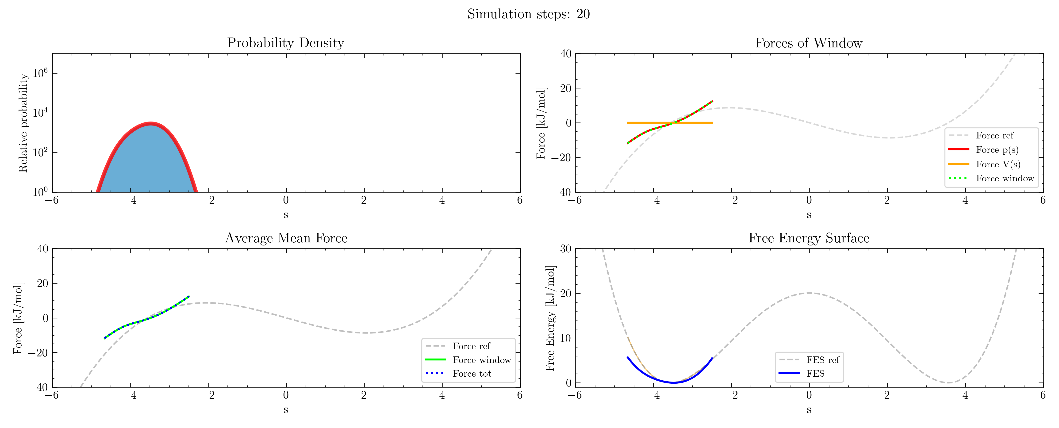
Mean Force Integration

Slide 6
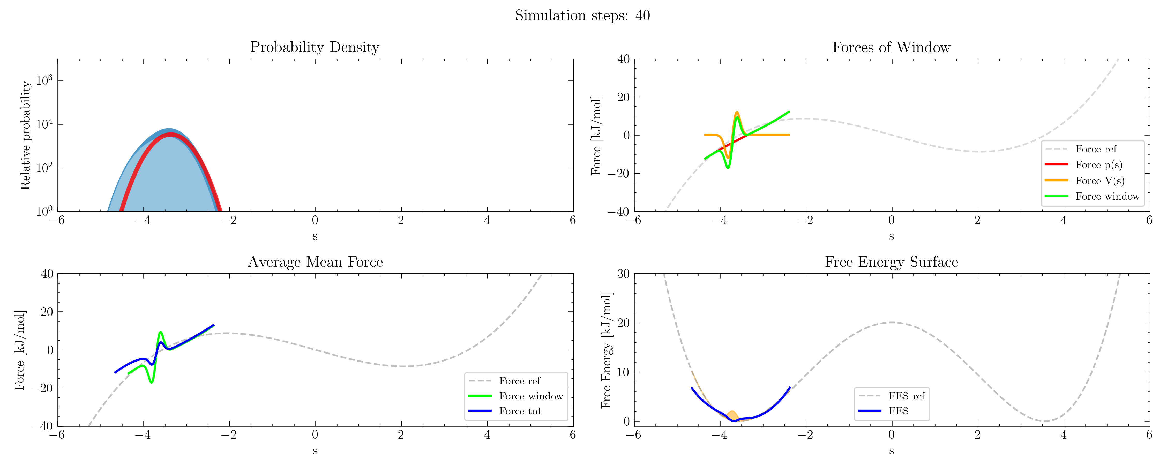
Mean Force Integration

Slide 7

Mean Force Integration

Slide 8
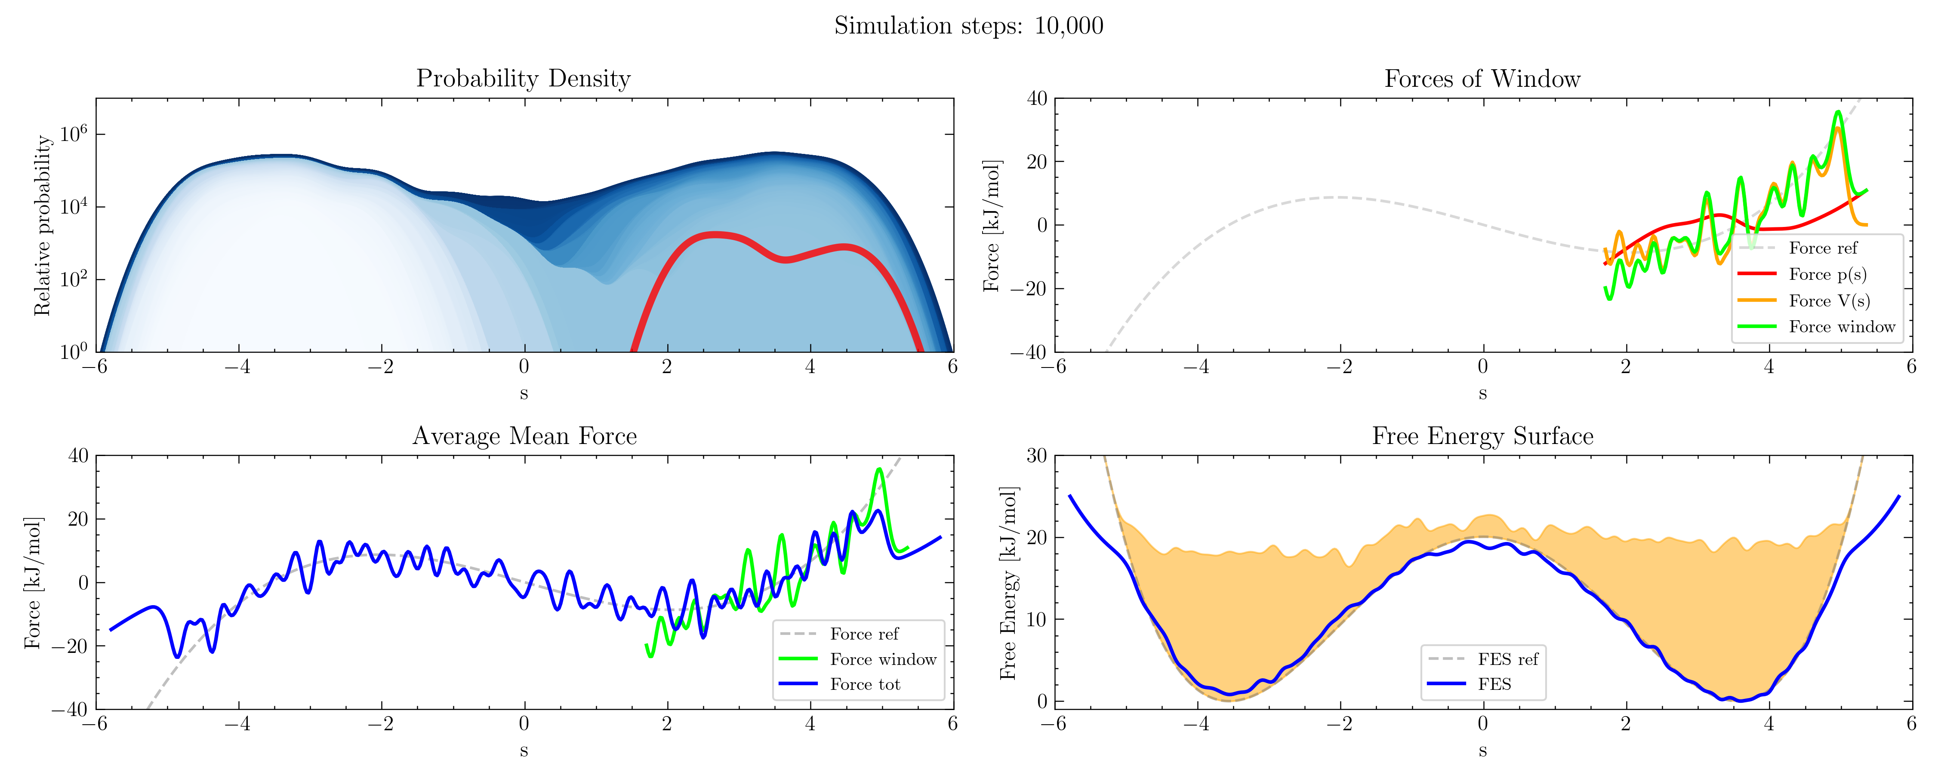
Mean Force Integration

Slide 9
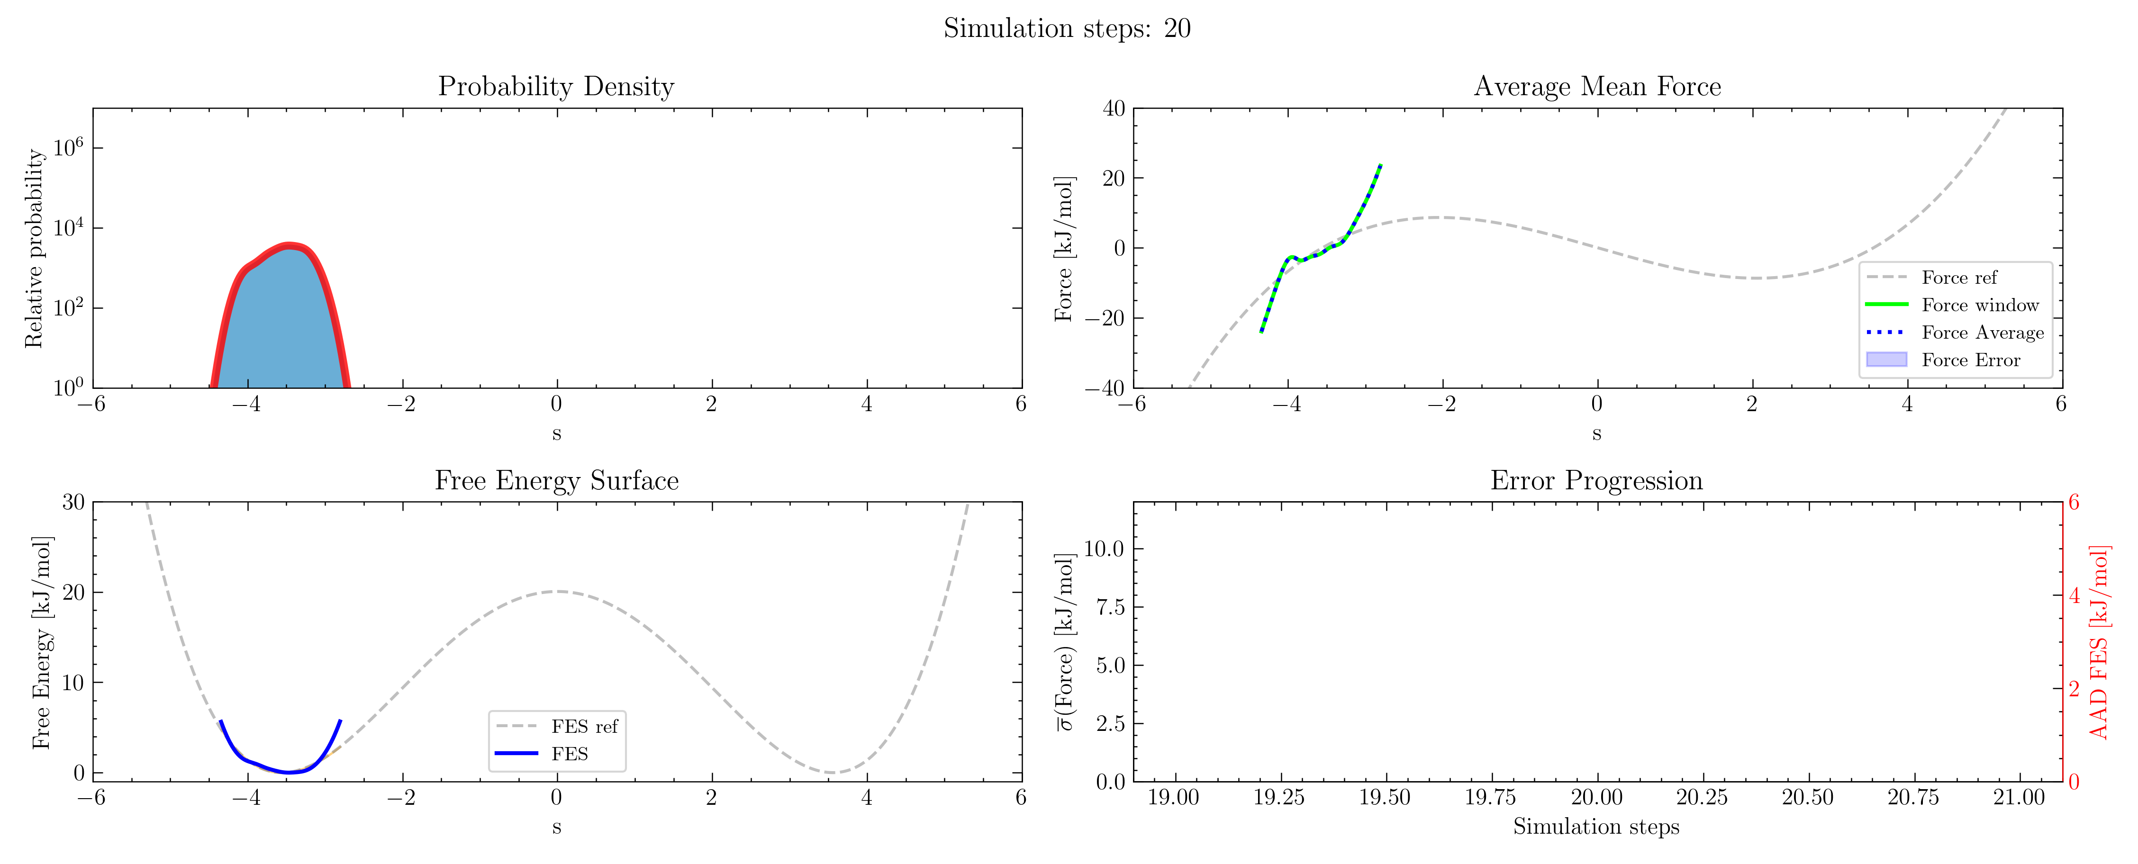
Convergence Estimator

Slide 10
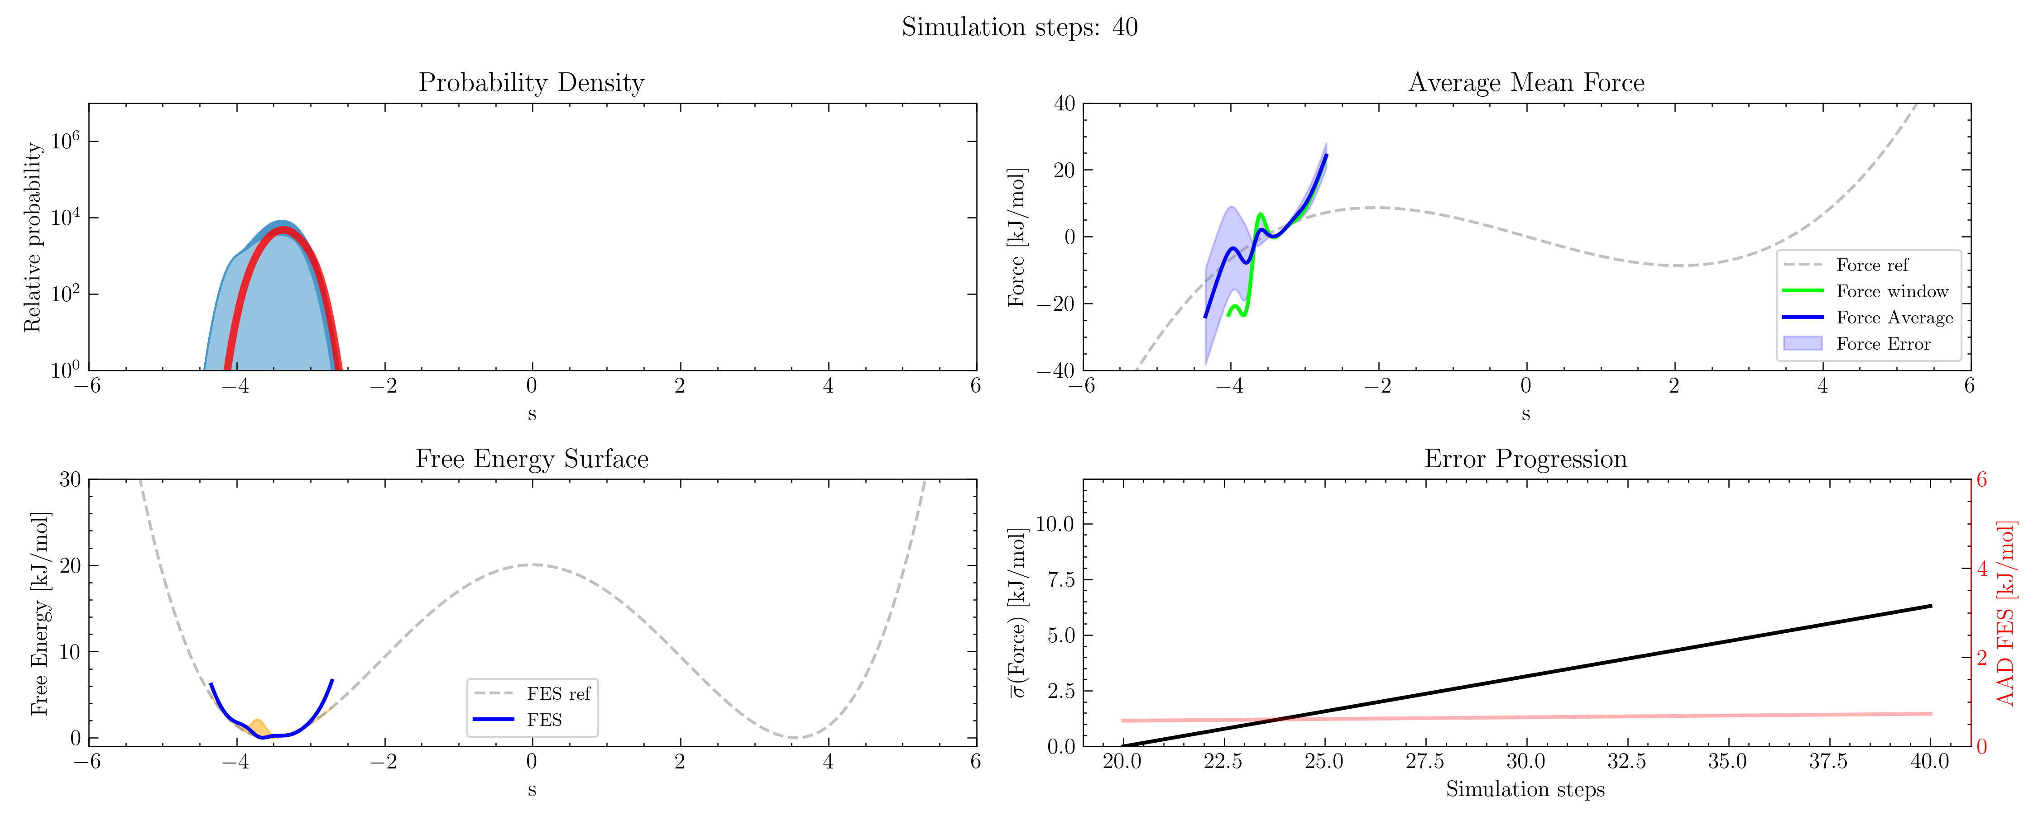
Convergence Estimator

Slide 11
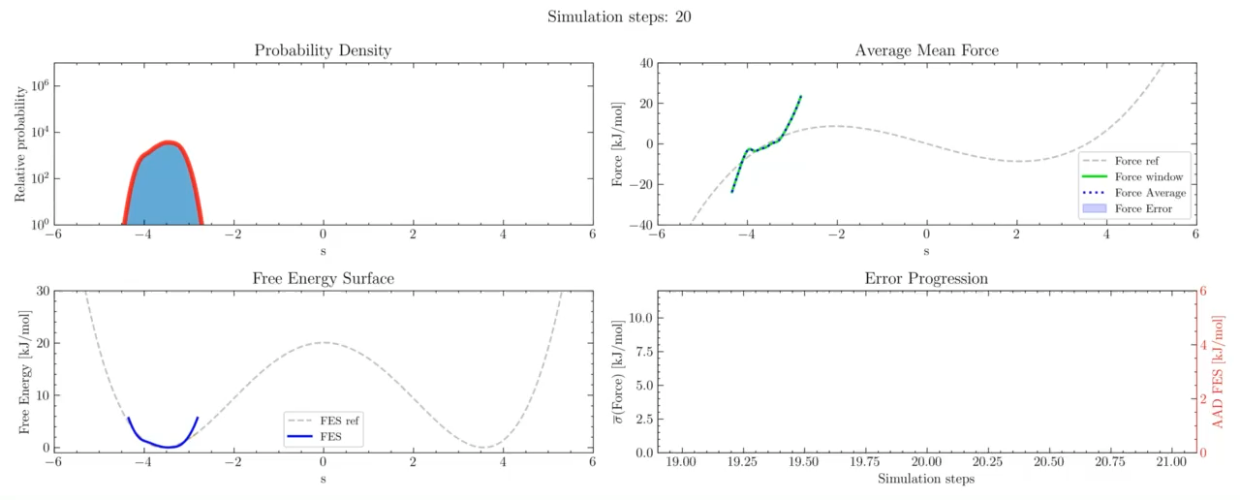
Convergence Estimator

Slide 12
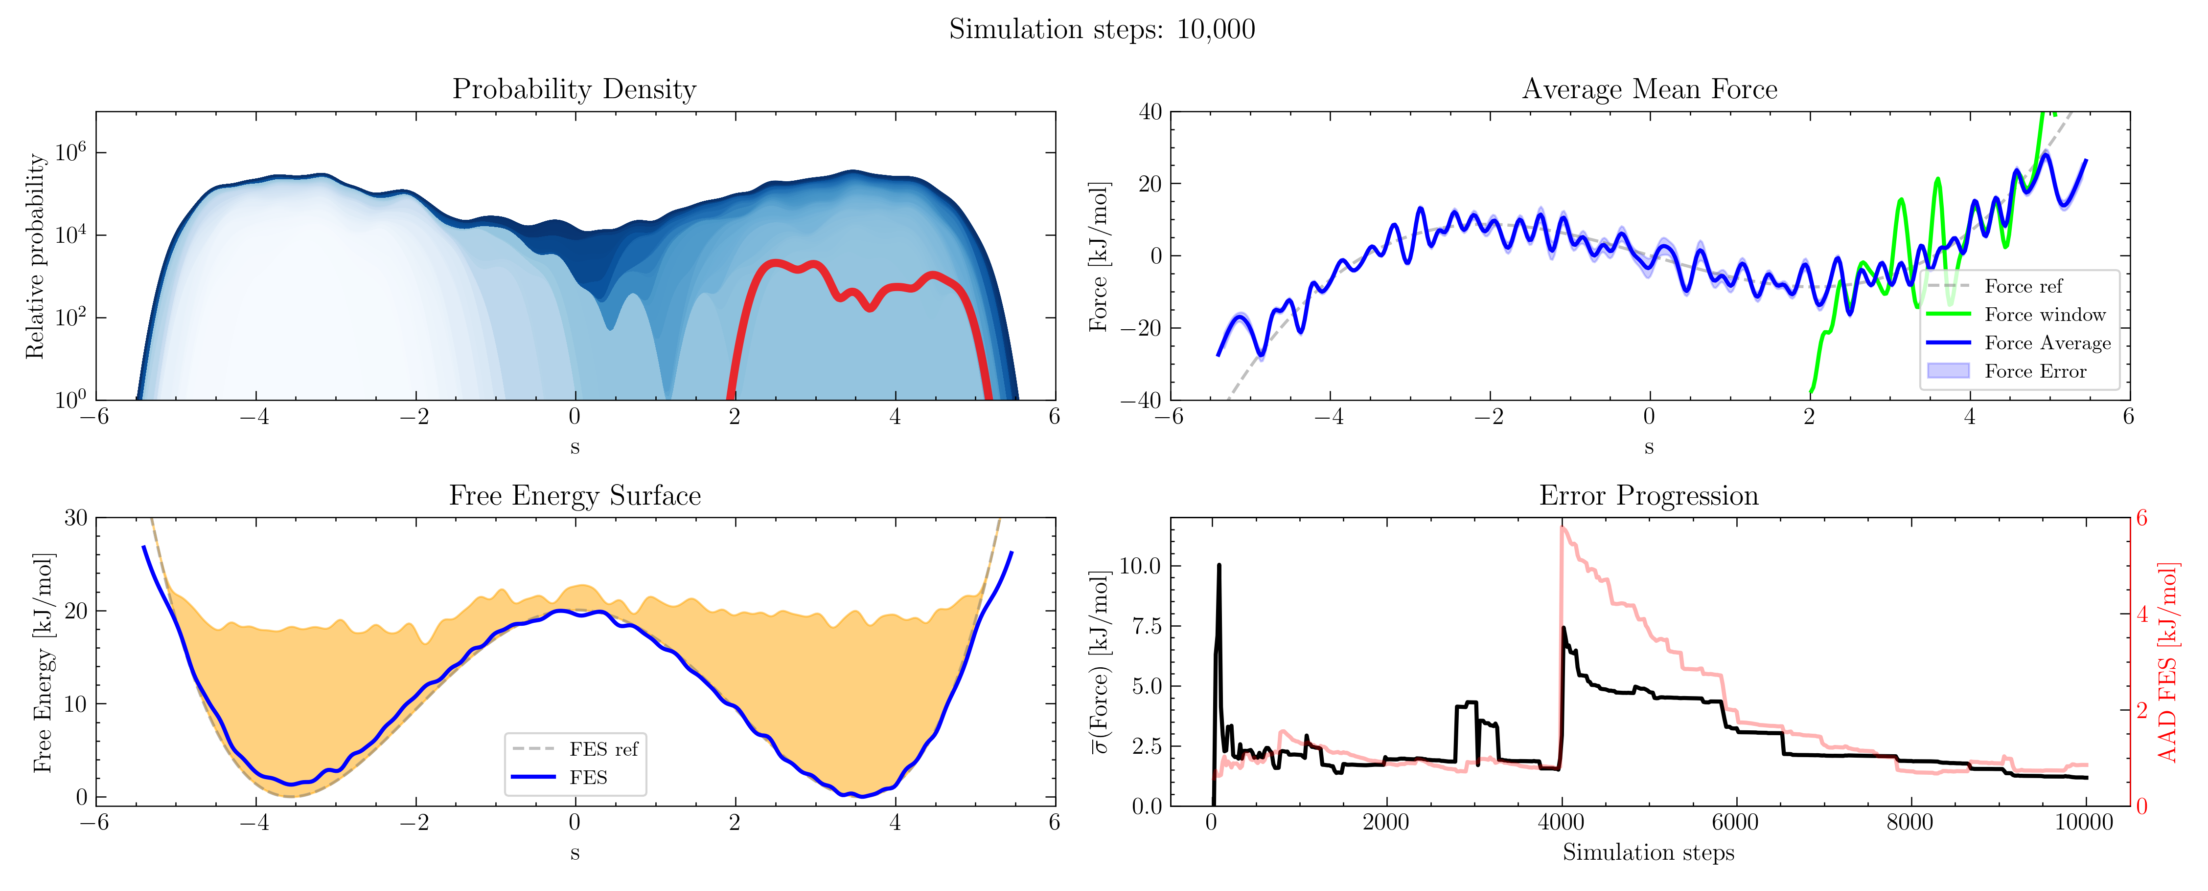
Convergence Estimator

Slide 13
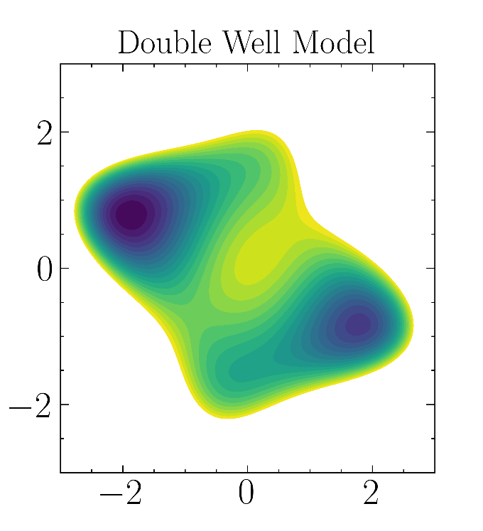
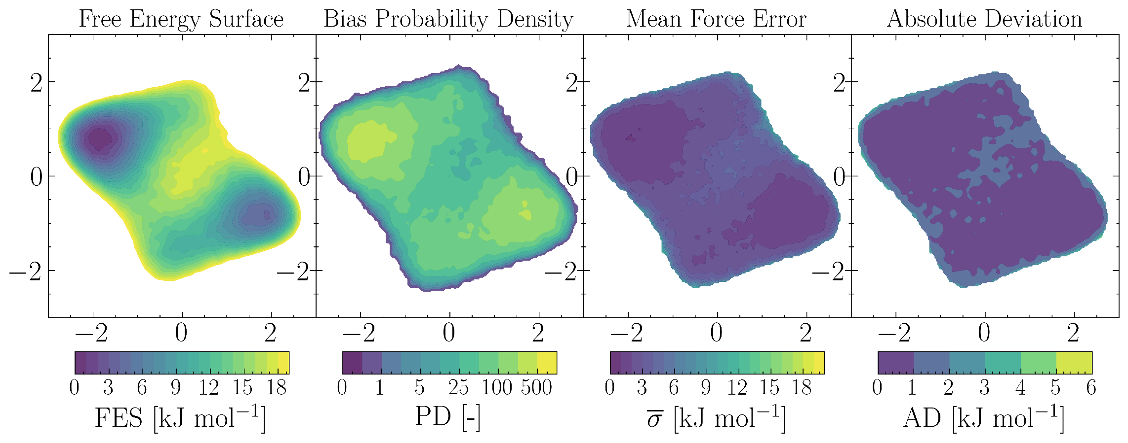
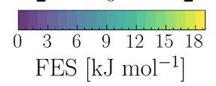
Example in 2D
Metadynamics simulation

Slide 14
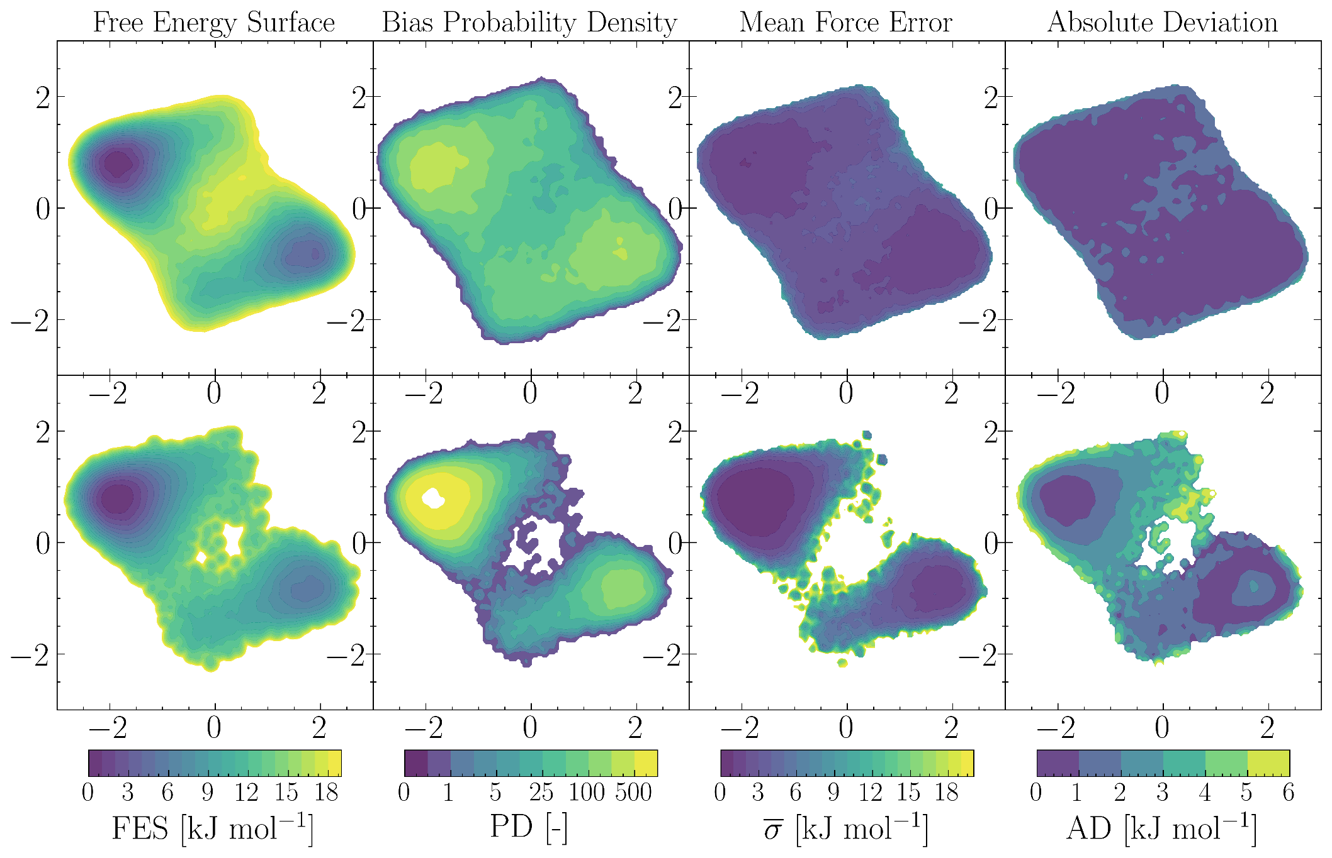
Example: Independent Simulations
Long Metadynamics Simulation
20 Short Metadynamics Simulations

Slide 15
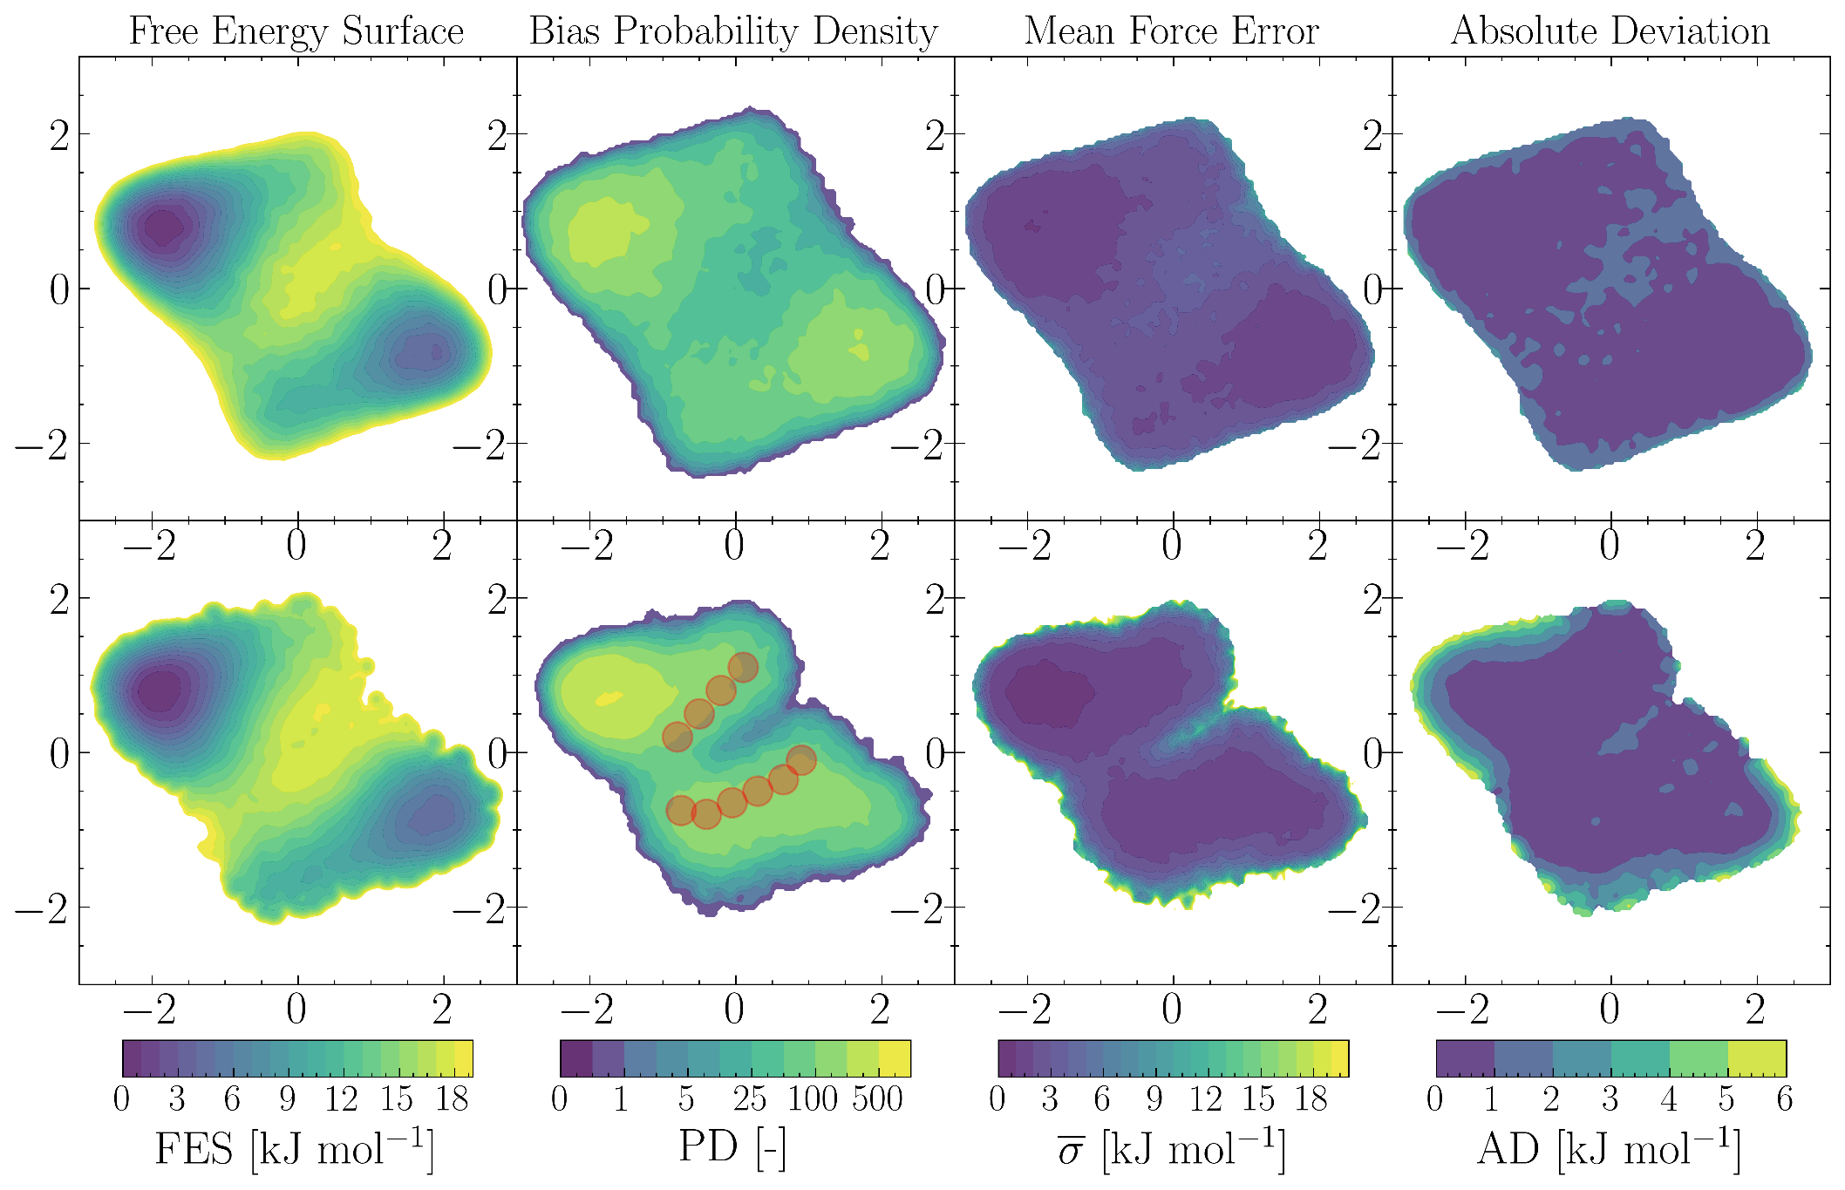
Example: Mixing Biases
Long metadynamics simulation
10 short metadynamics + 10 short metadynamics with umbrella sampling simulations

Slide 16
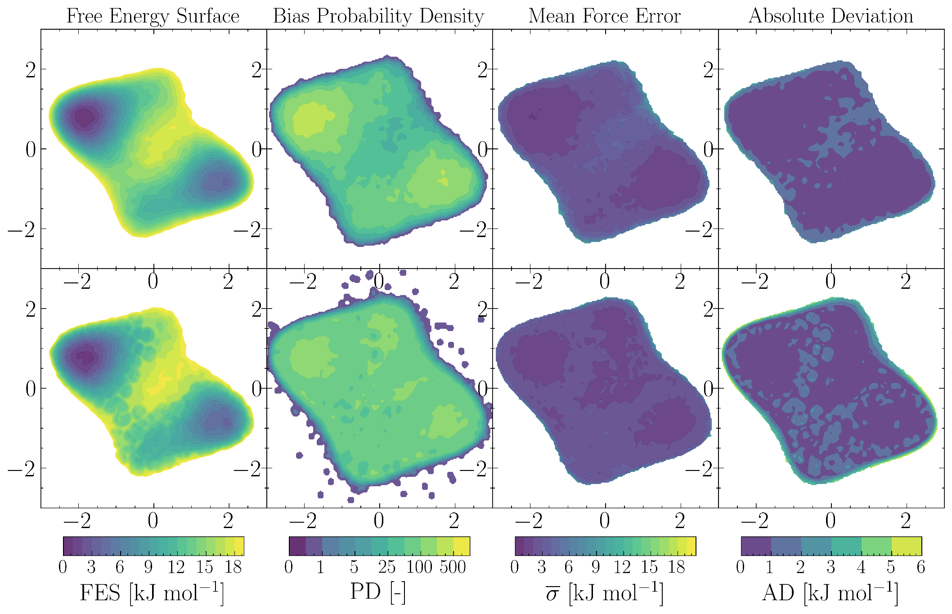
Example: Inverse FES Bias
Long metadynamics simulation
20 short metadynamics simulations with inverse FES bias

Slide 17
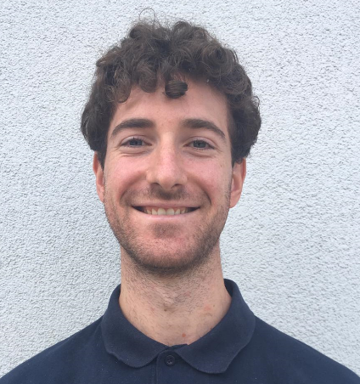
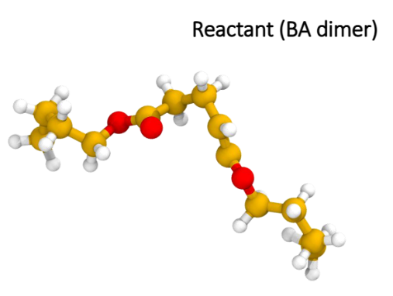
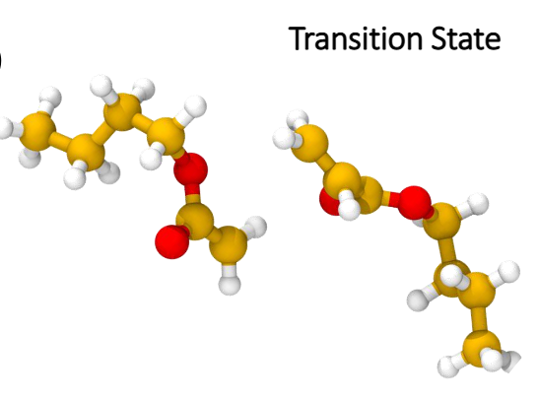
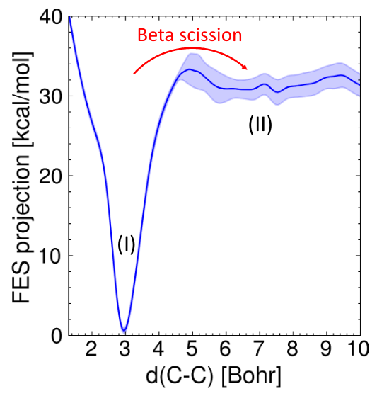
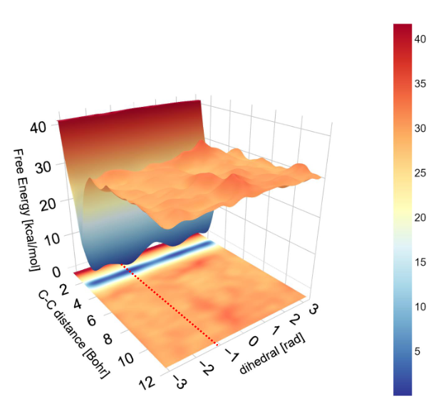
Ab-initio Metadynamics simulation
Dissociation of polymer-chain
Francesco Serse, Politecnico di Milano

Slide 18
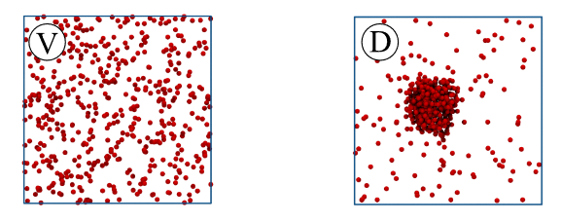
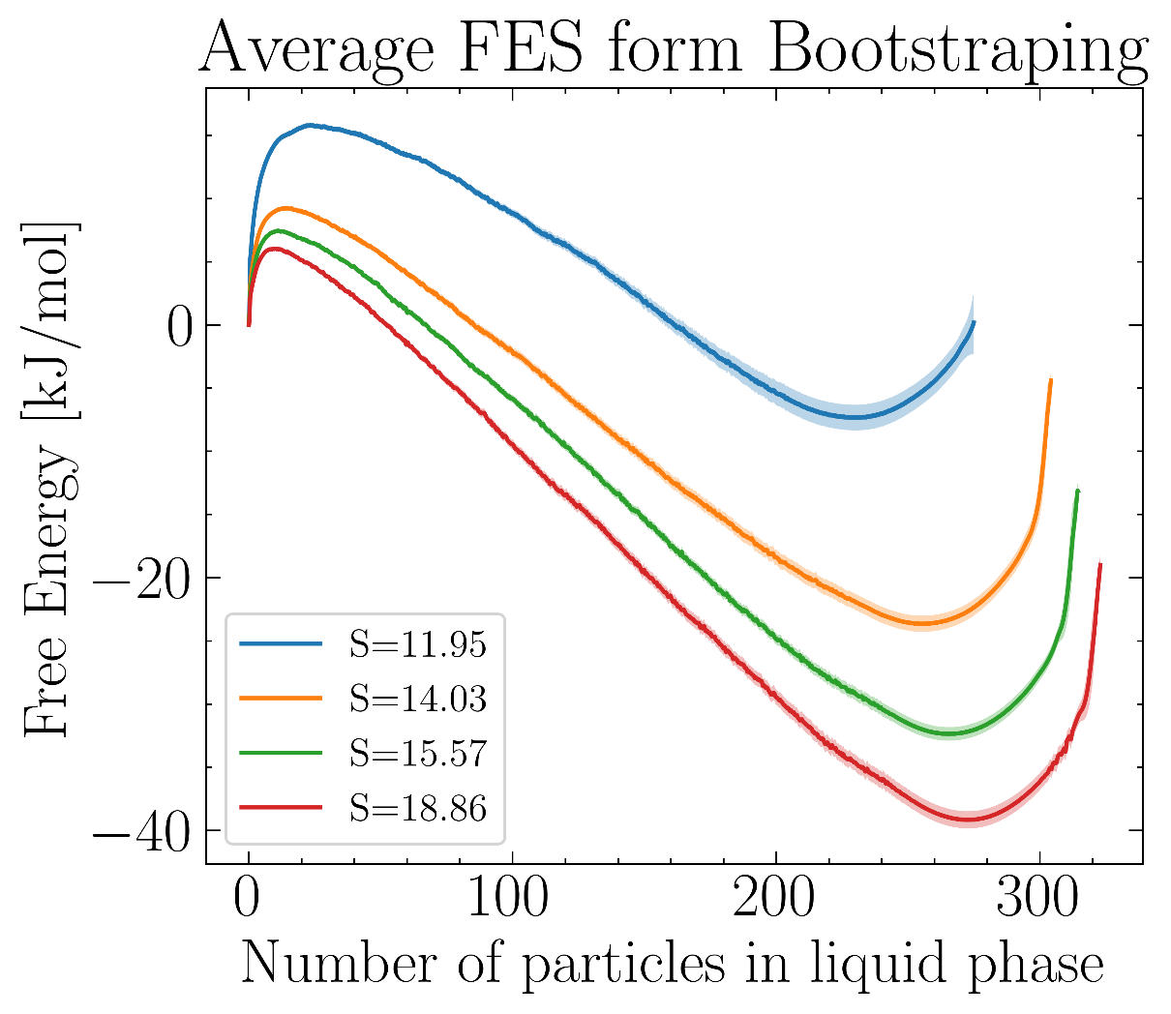
Nucleation of supersaturated Argon
Forward: Vapor forming liquid nuclei
→ Requires narrow biasing
Backward: Evaporation of liquid nuclei
→ Required wide biasing
Run 50 forward and 50 backward simulations
→ Stop after energy barrier sampled
Repeat for increasing supersaturations

Slide 19

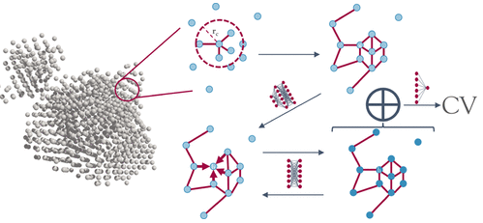
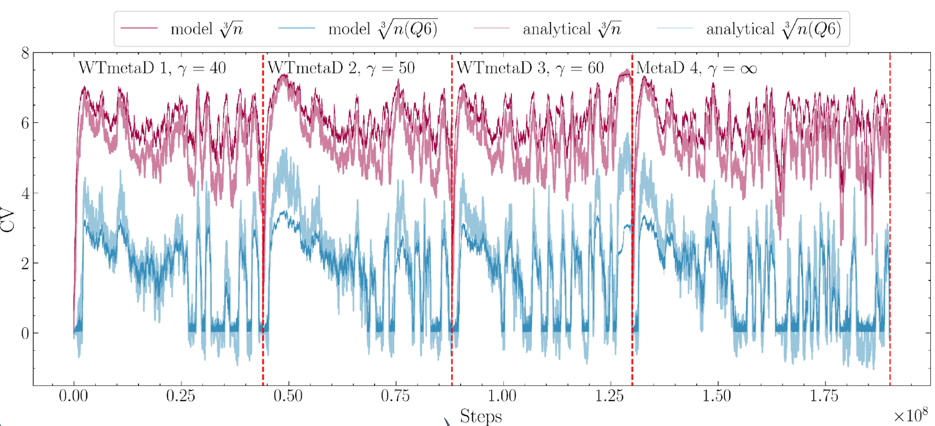
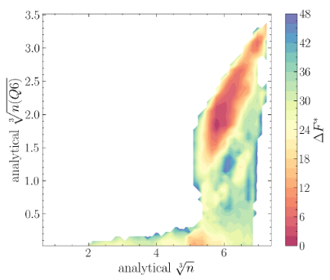
Nucleation of Colloidal System
Estimating CV using graph-NN
Florian Dietrich
UCL
[7] Dietrich F.; Advincula X.; Gobbo G.; Bellucci M, Salvalaglio M. “Machine Learning Nucleation Collective Variables with Graph Neural Networks”. J. Chem. Theo. Comp. 2023

Slide 20
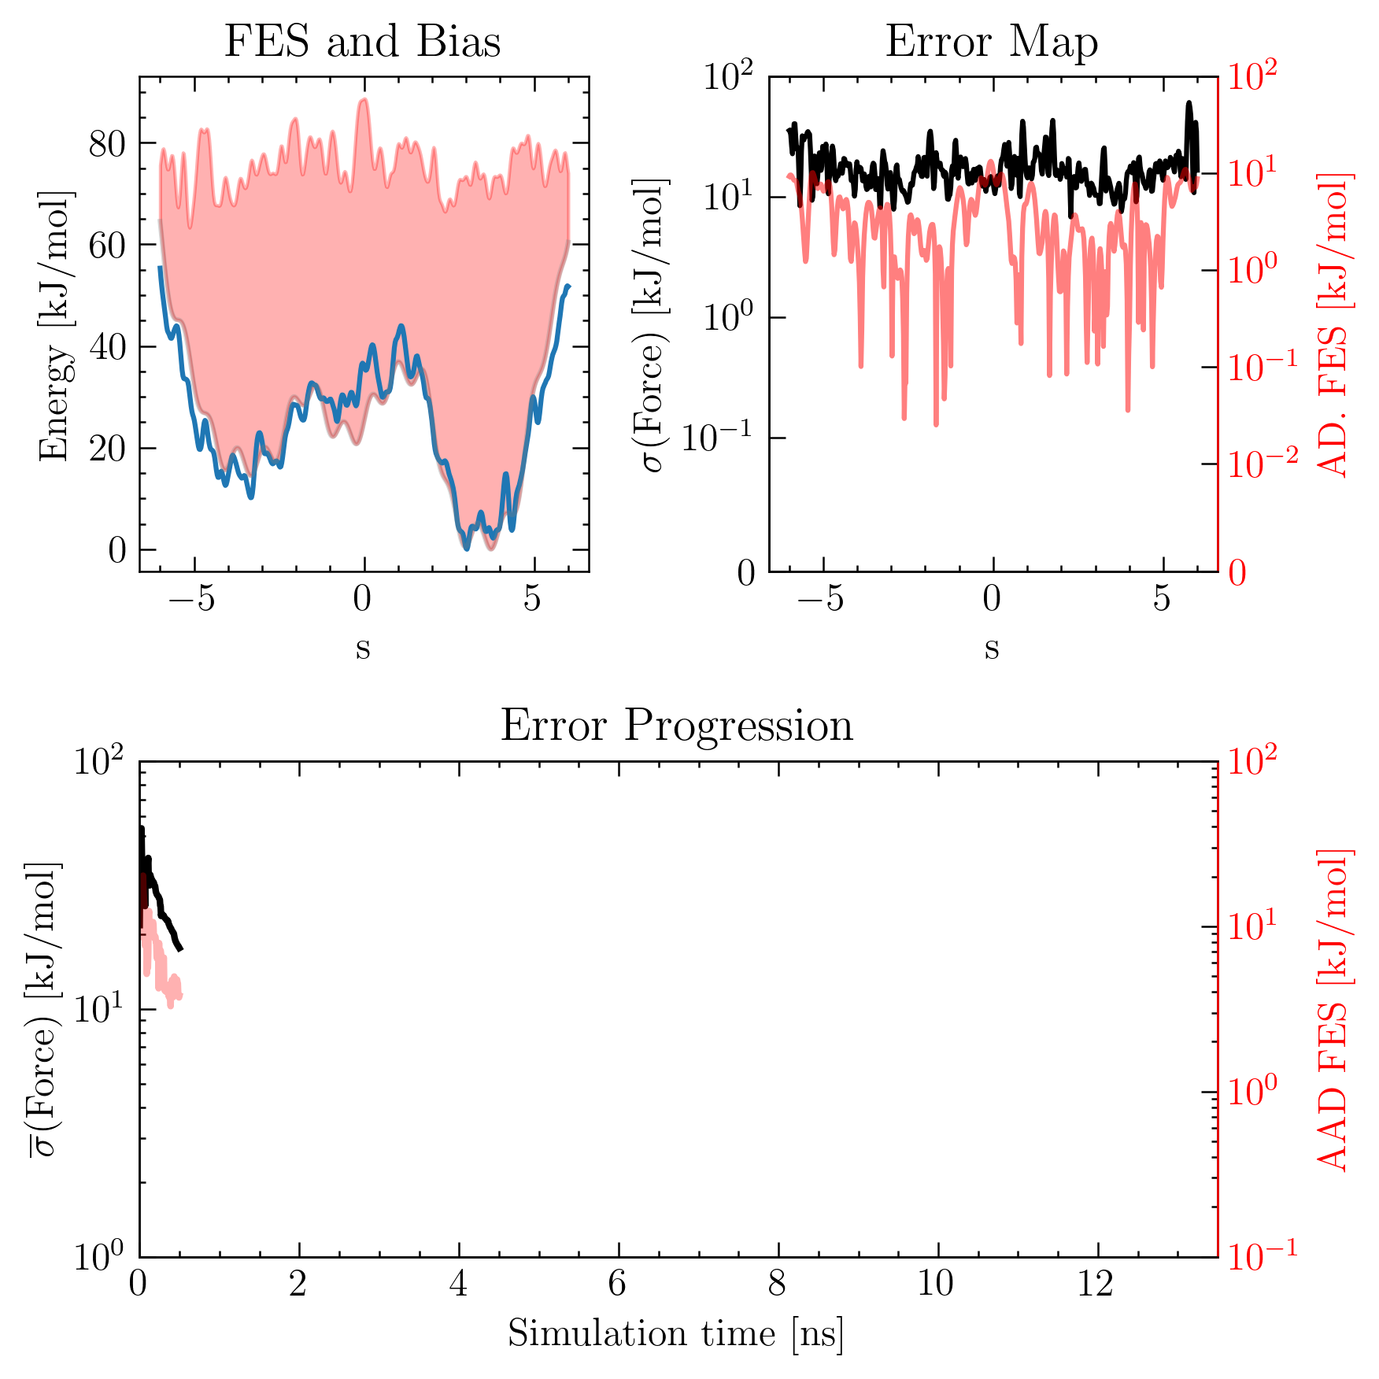
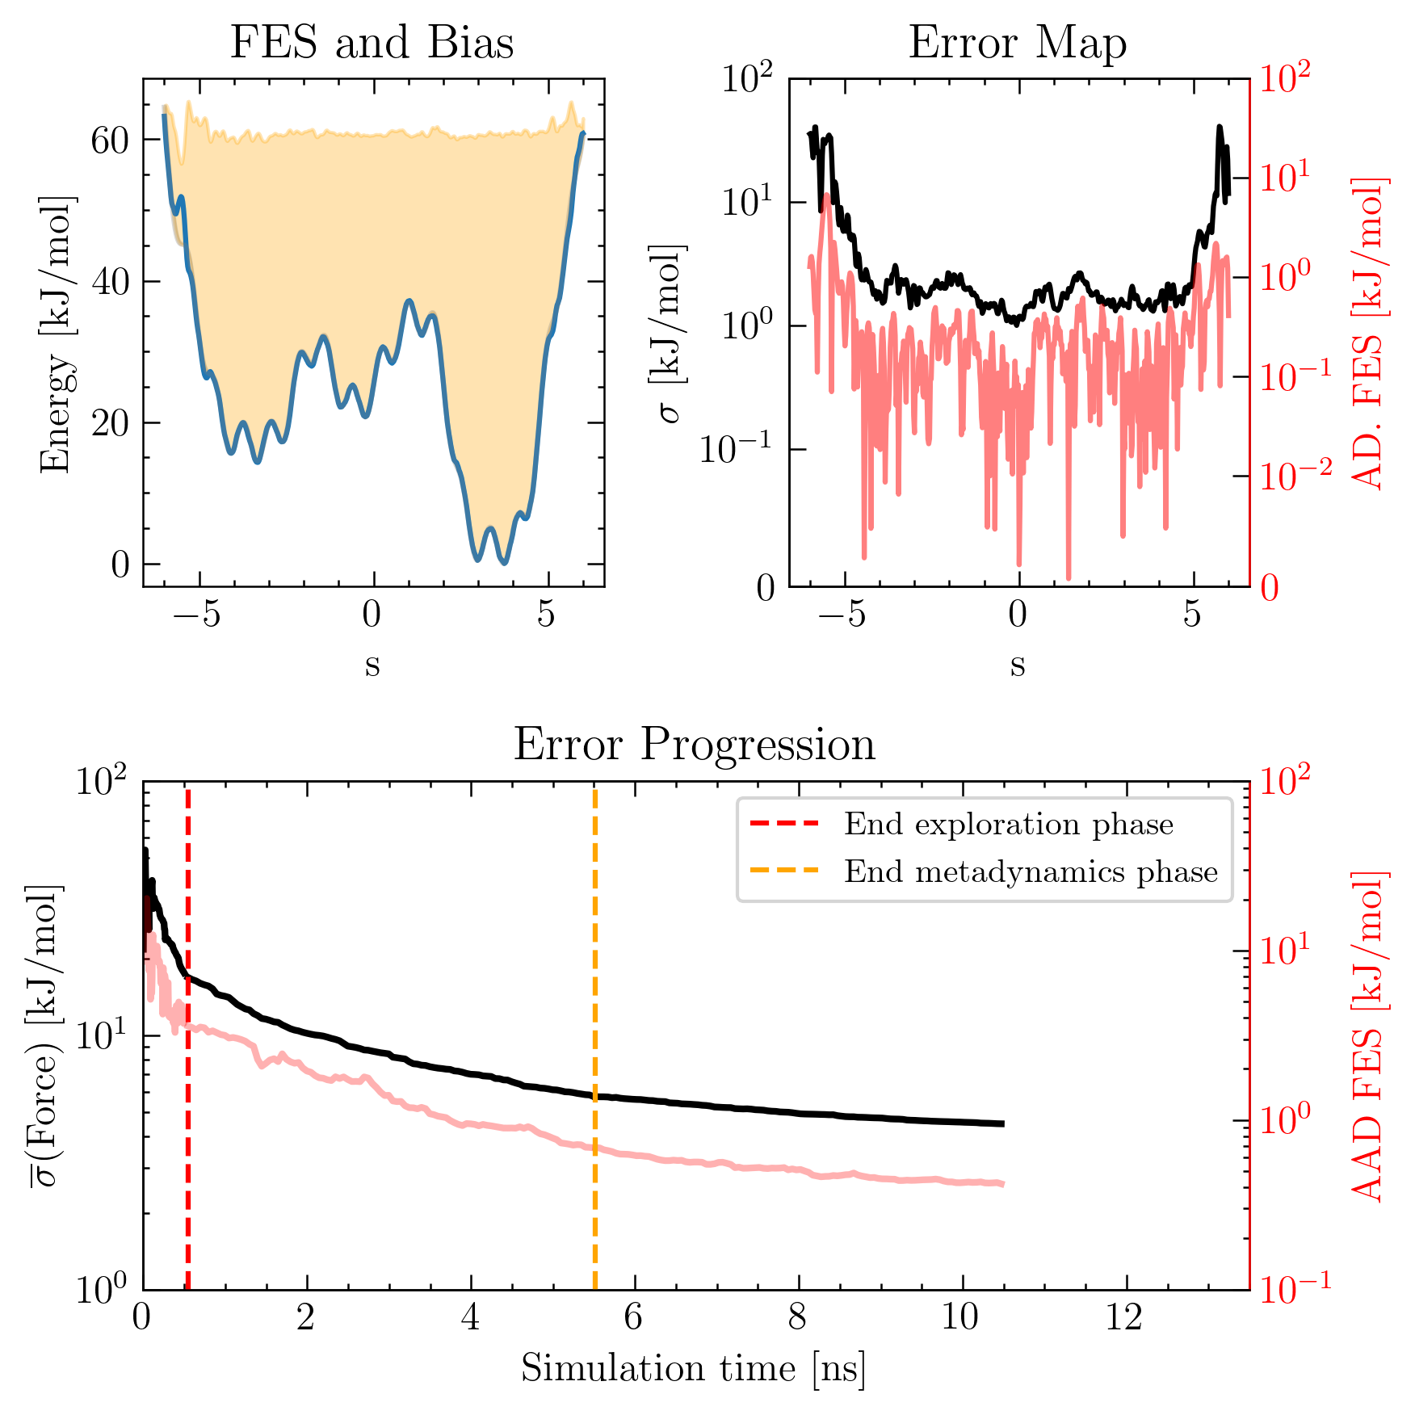
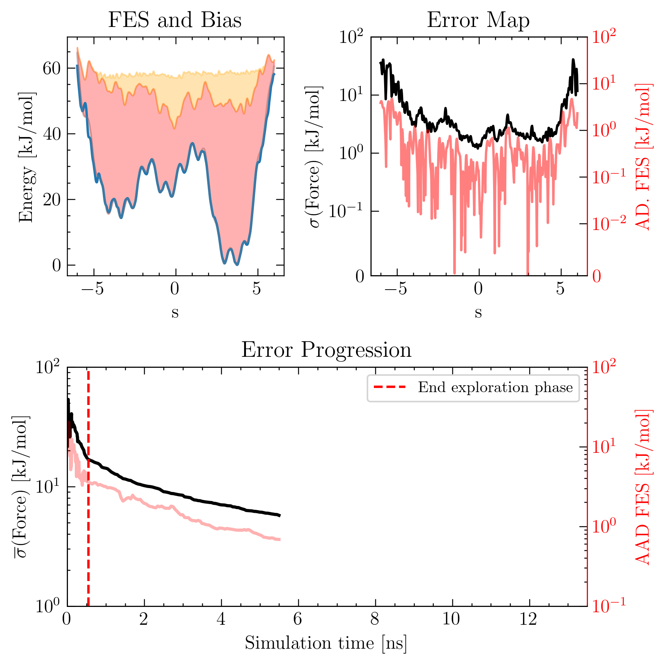
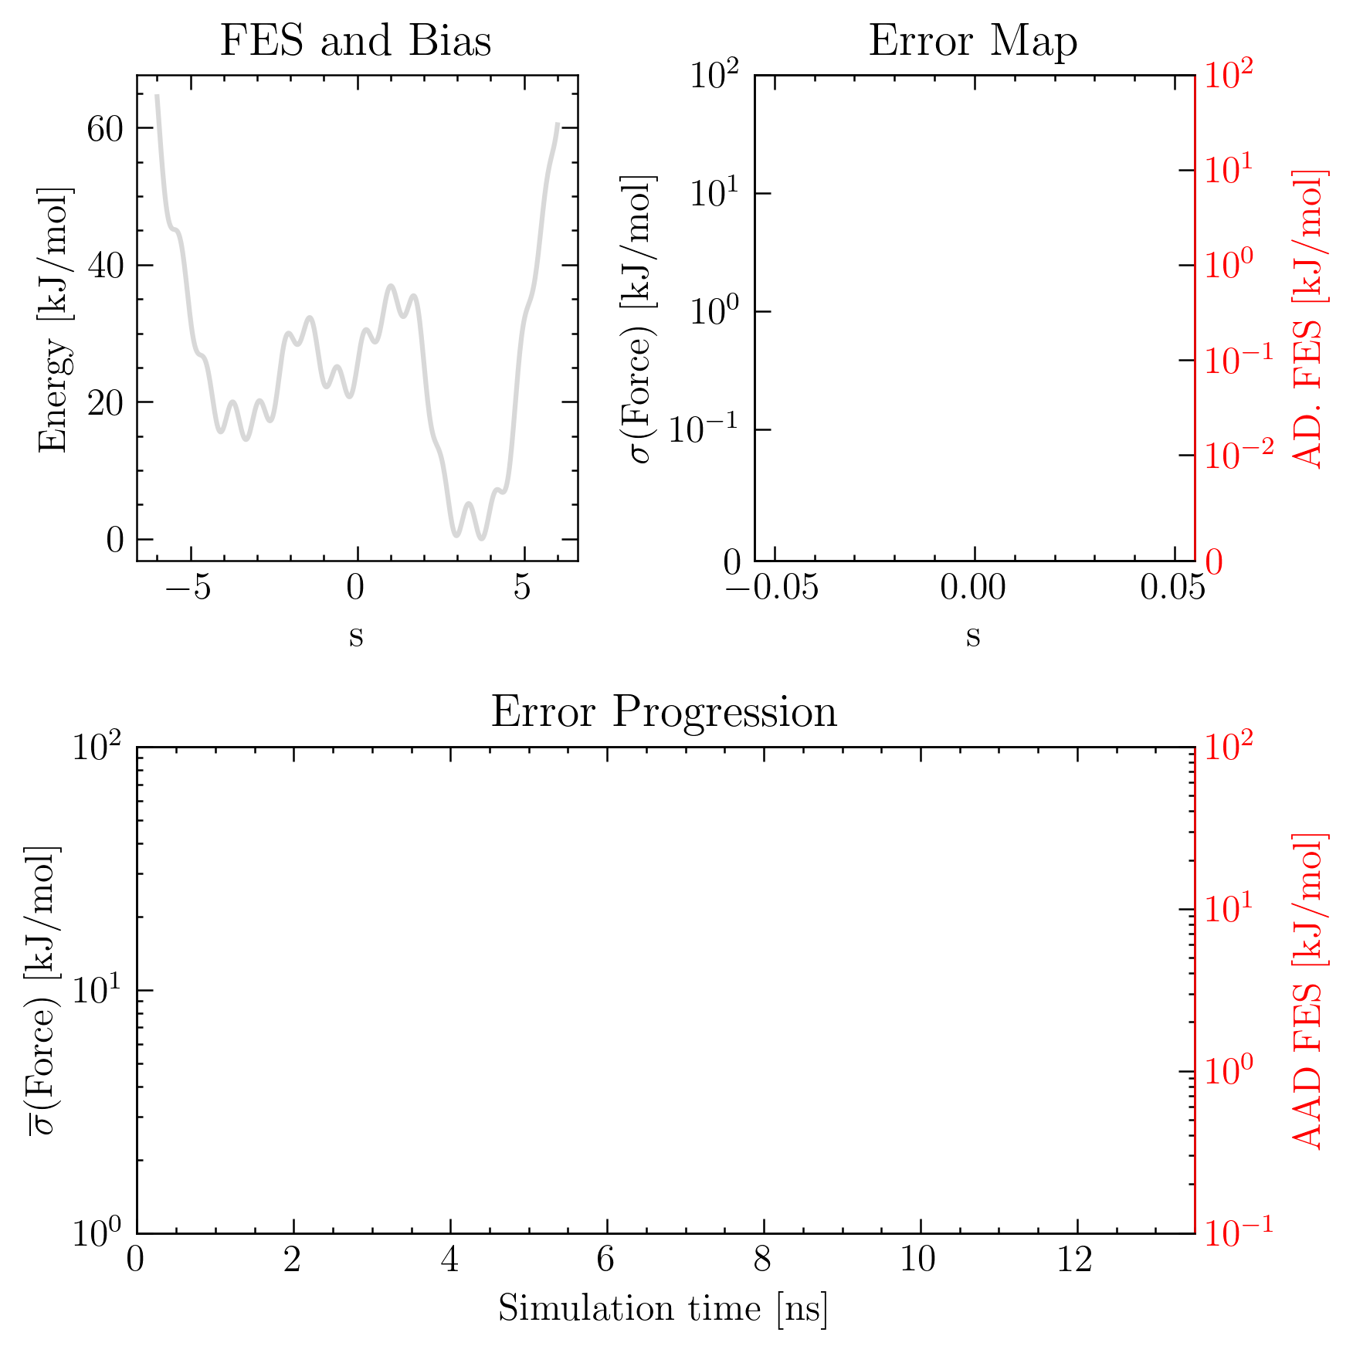
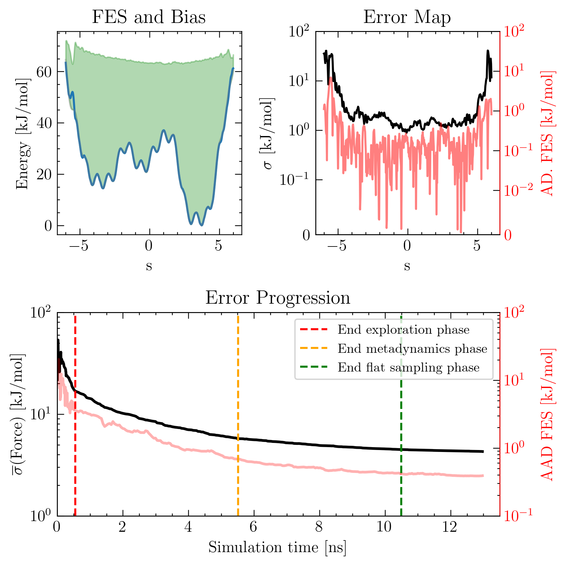
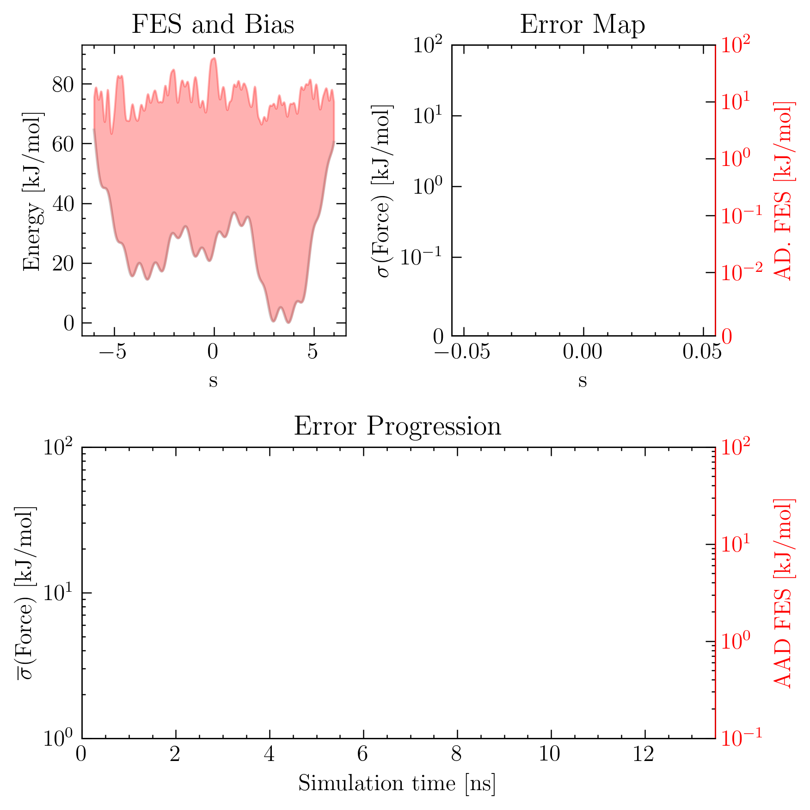
Outlook: Developing Biasing Strategies
Re-Initialising a simulation
Exploration phase
Aggressive metadynamics bias
Simulation 1
Simulation 2
Metadynamics phase
Inverse FES bias +
Gentle metadynamics bias
Simulation 3
Flat sampling phase
Only inverse FES bias
Simulation 4
Umbrella sampling phase Inverse FES bias +
Harmonic potential

Slide 21
Outlook: Developing Biasing Strategies
Re-Initialising parallel simulations
Simulation 1
5
12
15
15
Simulation 2
6
8
10
14
8
Simulation 3
7
11
15
8
Simulation 4
9
13
16
15

Slide 22
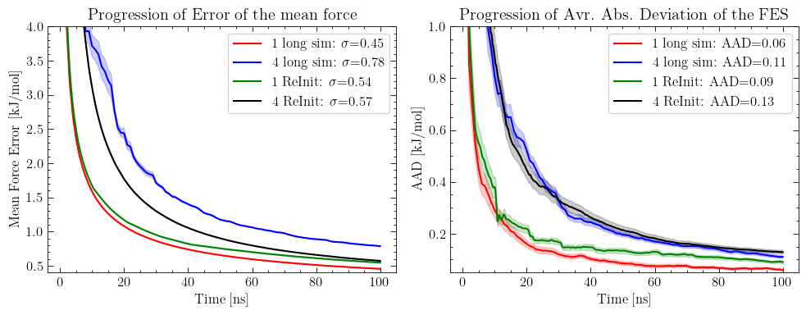
Comparing Biasing Strategies

Slide 23
Mean Force Integration
Additional flexibility to run biased MD simulations
Combine independent simulation
Multiple forms of bias potential
Real-time convergence estimation
Guide to terminate and re-initialise simulations
Optimization of computational resources

Slide 24
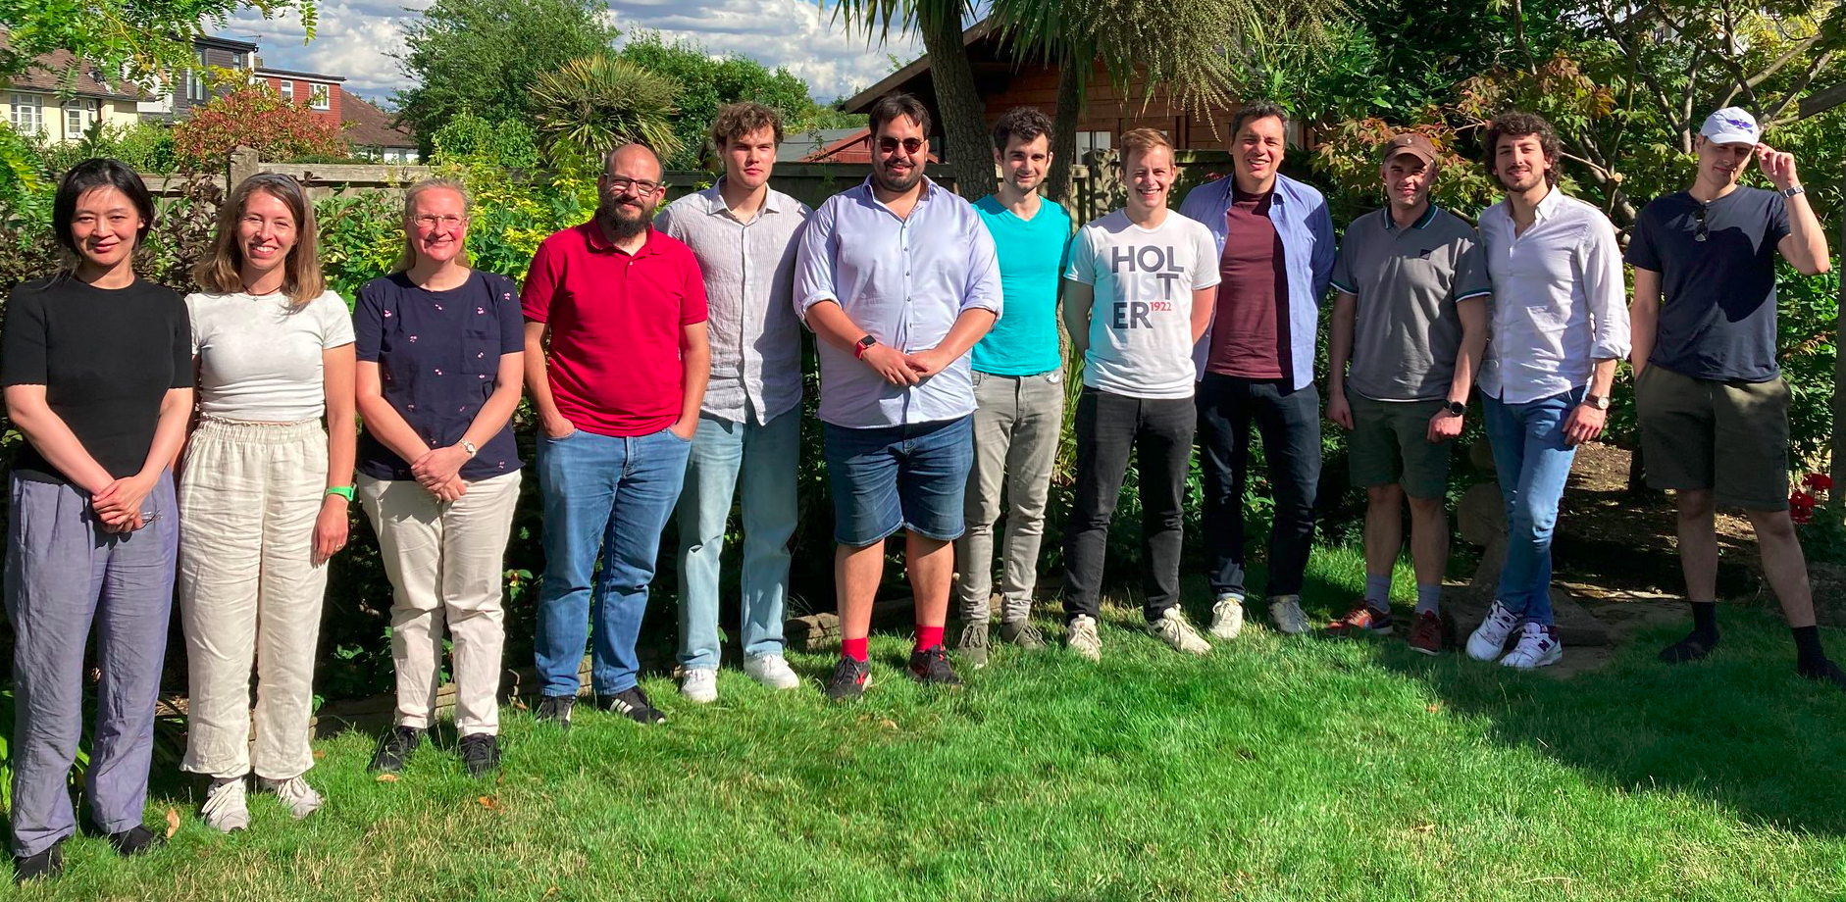
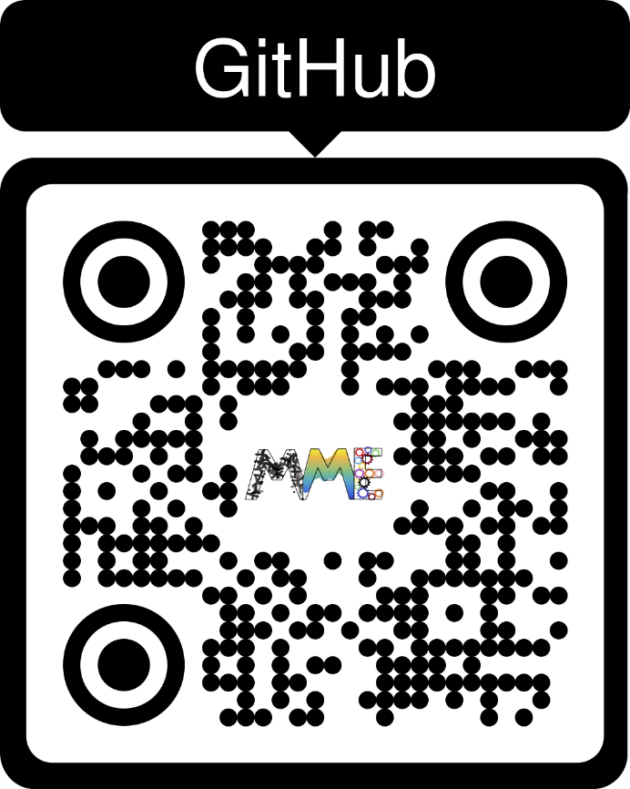
Thank you!
github.com/mme-ucl/MFI

Slide 25
Convergence with Force sampling
Sampling the gradient of the free energy rather than the absolute free energy → Better convergence
References:
[A1] Heras D.; Schmidt M. “Better Than Counting: Density Profiles from Force Sampling”. Phys. Rev. Lett. 2017
[A2] Rottenberg B. "Use the force! Reduced variance estimators for densities, radial distribution functions, and local mobilities in molecular simulations". J. Chem. Phys. 2020

Slide 26
Title
txt
txt

